Slide 1
Lecture 09: Conditionals and Control Flow
Understand and use Boolean expressions, if, elif, else, nested if-else statements, and program control flow
Kok-Seng Wong | 2021

Slide 2

Discussion
Who or what typically finds runtime errors?
Compiler/Interpreter
Programmer
Computer

Slide 3
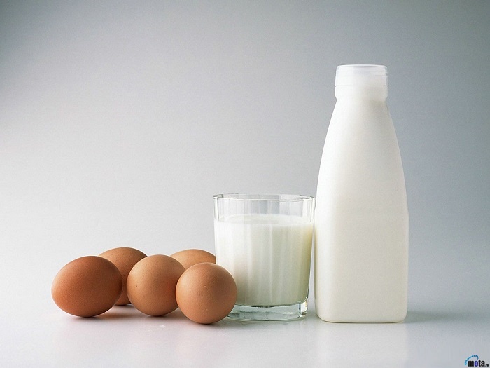
Motivation example 1
Ali Baba’s mom said: “Yah, please go to the Vinmart and buy one bottle of milk. If they have eggs, bring 6.”
Ali Baba came home with ?

Slide 4
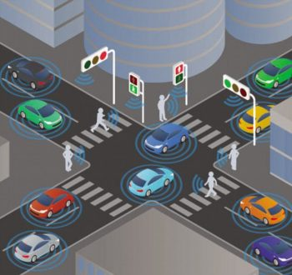
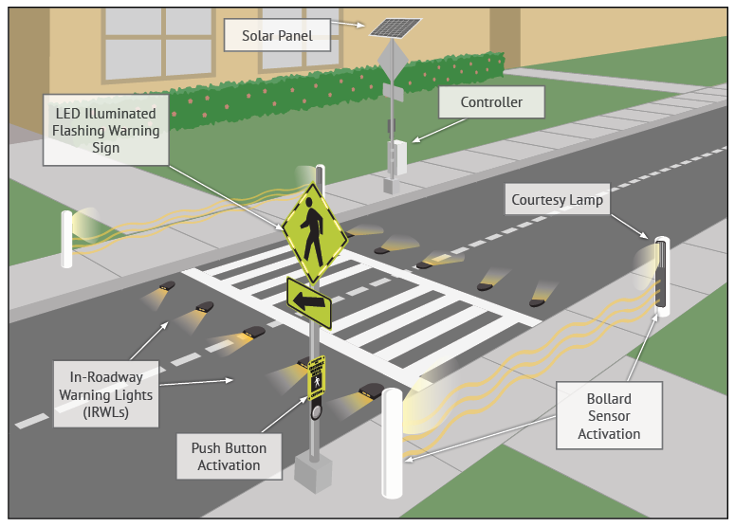
Motivation example 2
Traffic light system
Smart Crosswalk
Flow Control!
[source]
[source]

Slide 5
Learning outcomes
Upon the completion of this lecture, students will be able to:
describe the syntax for conditional statements in Python.
understand the control flow of if, else, elif, and nested if-else statements.
write conditional statements in Python to control the flow of code.

Slide 6
Logical conditions (mathematics)
Equals: a == b
Not Equals: a != b
Less than: a < b
Less than or equal to: a <= b
Greater than: a > b
Greater than or equal to: a >= b

Slide 7
Conditionals: if-statements
Format:
If<boolean-expression> is true, then execute all of the statements indented directly underneath (until first non-indented statement).
condition
if<boolean-expression>:
<statement>
…
<statement>
<following_statement>
The colon (:) separates the header of the compound statement from the body.
Second line must be indented

Slide 8
Conditionals: if-statements
Format: (other programming languages)
if<boolean-expression>{
<statement>
…
<statement>
}
<following_statement>

Slide 9
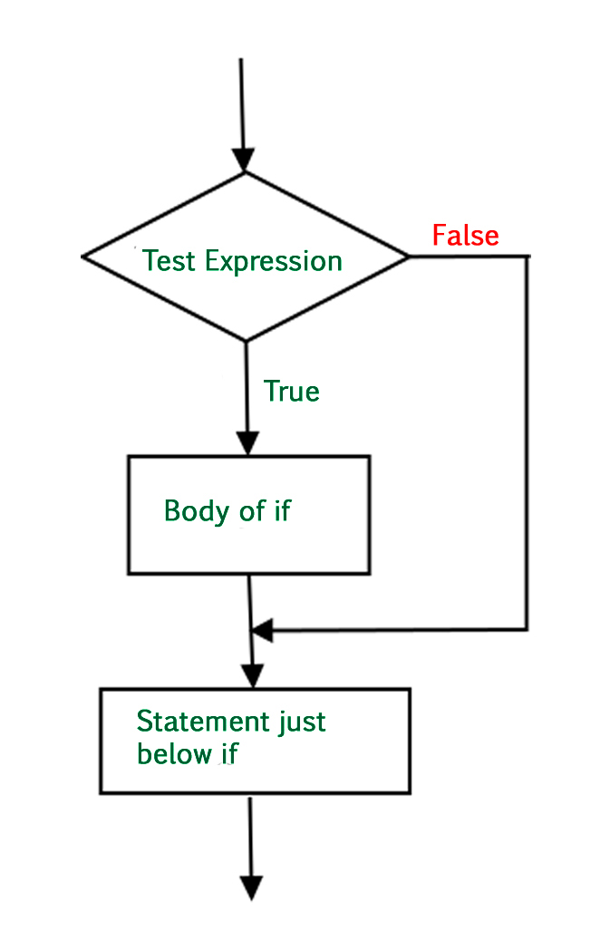

Control flow: if-statement
[source]

Slide 10
Boolean expressions
Boolean variables:
Used to evaluate to a Boolean value (True or False).
if is_raining:
print("You need an umbrella!")
Boolean comparisons:
if temperature > 28:
print("Nice temperature!")
is_raining = False
is_sunny = True
temperature = 32
Boolean operations:
if not is_raining and is_sunny:
print("Let's go out for a walk!")
if temperature > 30 or is_sunny:
print("You should stay at home!")

Slide 11
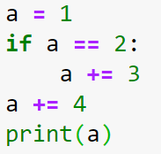
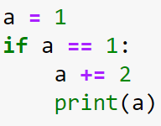
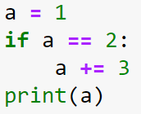
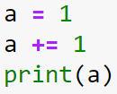

Class practice
E
C
D
B
A

Slide 12

Conditionals: if-else-statements
Format:
if<boolean-expression> is true, then execute statements indented under if; otherwise, execute the statements indented under else
if<boolean-expression>:
<statement>
…
else:
<statement>
…

Slide 13
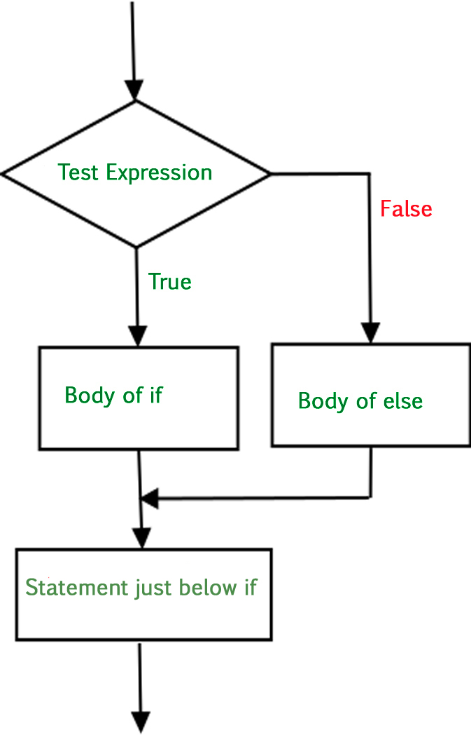
Control flow: if-else
Flow: program only takes on path during an execution
[source]

Slide 14
Control flow: if-else
Flow: program only takes on path during an execution
[source]

Slide 15
Control flow: if-else
Flow: program only takes on path during an execution
[source]

Slide 16
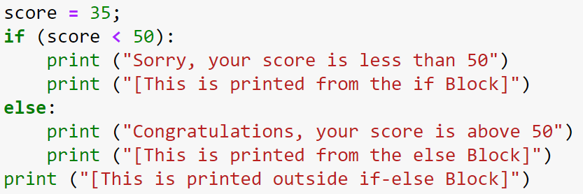
If-else example
A
A
B
C
B
C
D
D
What is the output?

Slide 17
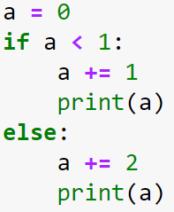
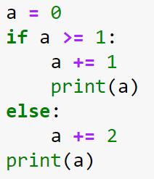
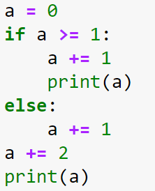
Class practice
A
B
C

Slide 18
Conditionals: if-elif-else-statements
Format:
if<boolean-expression>:
<statement>
…
elif<boolean-expression>:
<statement>
…
else:
<statement>
…
If the previous conditions were not true, then try this condition!

Slide 19
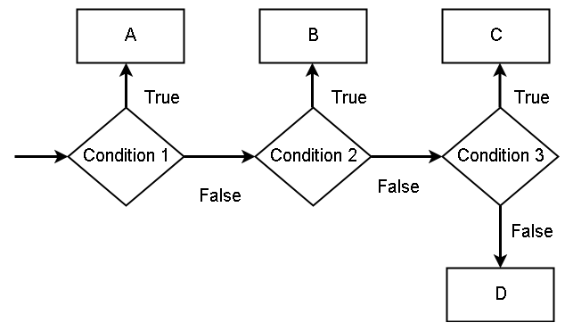
If-elif-else logic
from elif-block
from if-block
from elif-block
from else-block
[source]

Slide 20
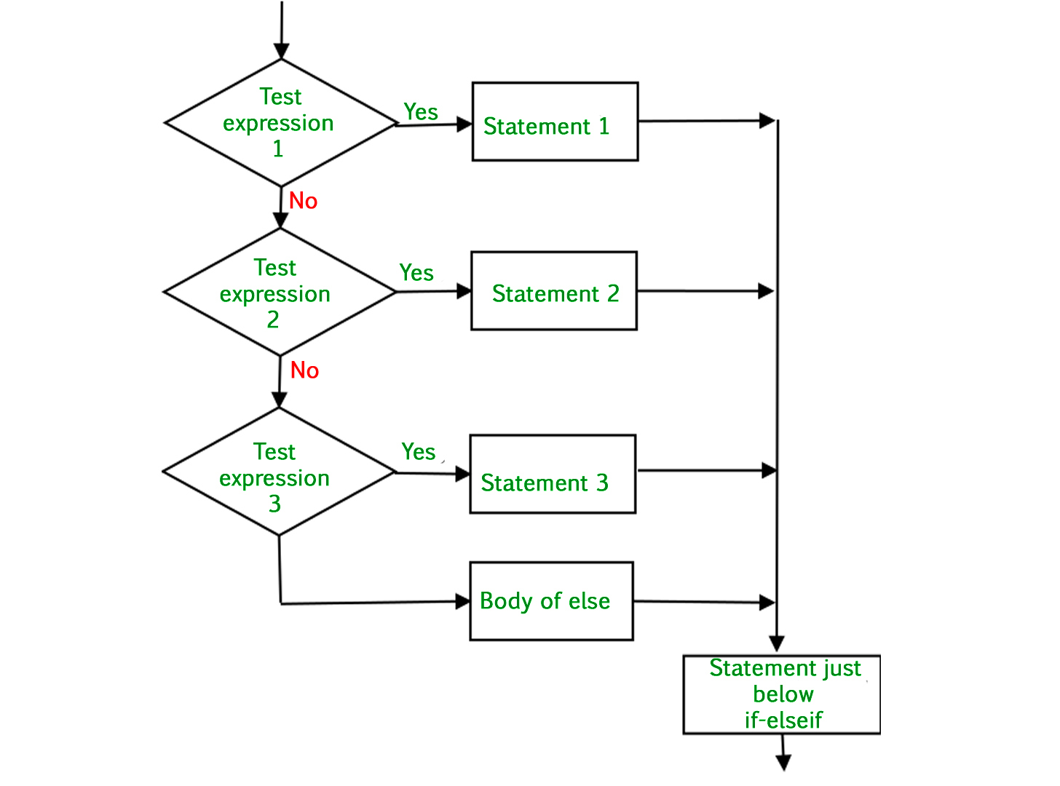
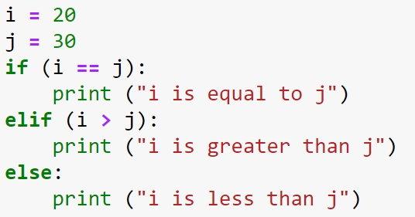
Flow chart: if-elif-else
[source]

Slide 21
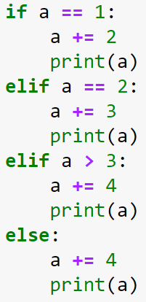
Class practice
a = 0
a = 8
a = -5

Slide 22
Common mistakes (1/4)
ks_age = 20
if ks_age <30:
print("You are young!")
elif ks_age <25:
print("You are super young!")
else:
print("You are still young!")
Output?

Slide 23
Common mistakes (2/4)
ks_age = 30
if ks_age <20:
print("You are super young!")
elif ks_age < 30:
print("You are young!")
else ks_age > 30:
print("You are still young!")
Output?

Slide 24
Common mistakes (3/4)
ks_age = 30
if ks_age <20:
print("You are super young!")
elif ks_age = 30:
print("You are young!")
else:
print("You are still young!")
Output?

Slide 25
Common mistakes (4/4)
ks_age = 30
if ks_age <20:
print("You are super young!")
elif ks_age == 30:
print("You are young!")
else:
print("You are still young!")
Output?

Slide 26
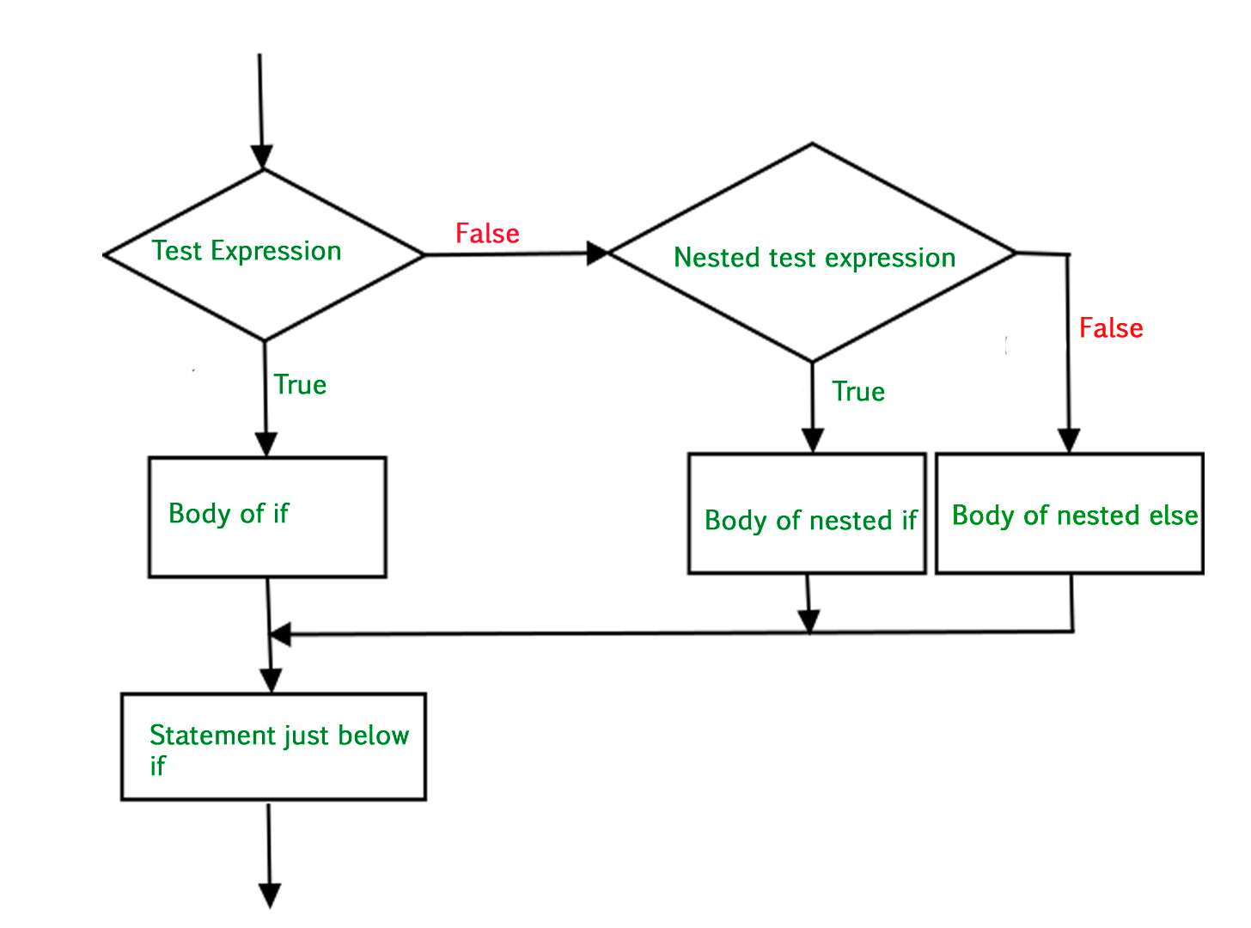

control- flow: Nested-if-else
[source]

Slide 27
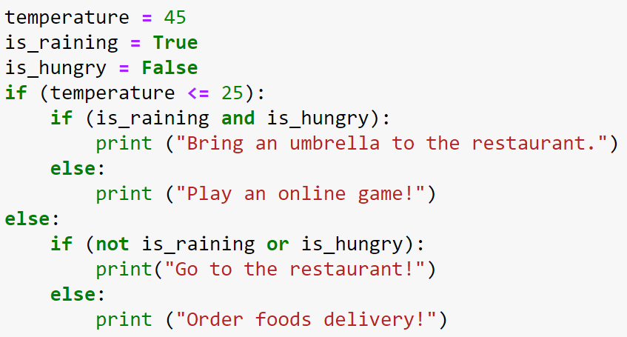
Nested if-else – example 1

Slide 28
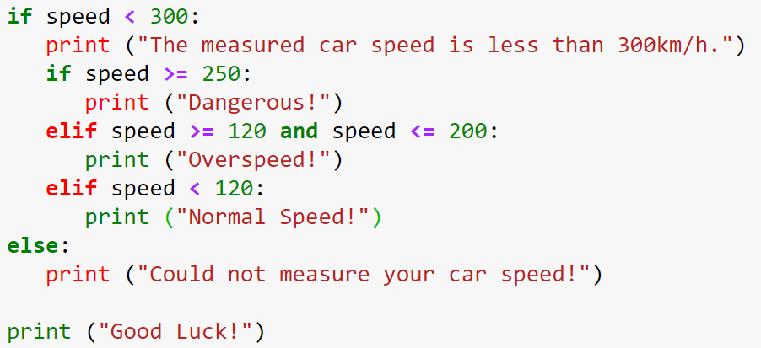
Nested if-else – example 2
speed = 100

Slide 29
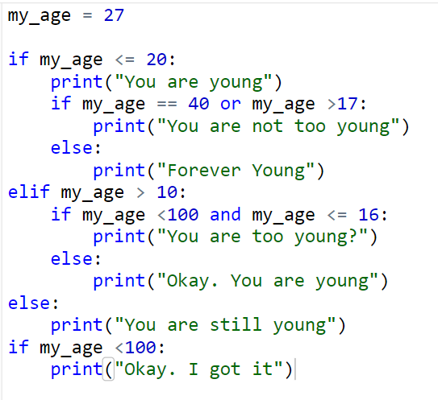
Nested if-else – example 3

Slide 30
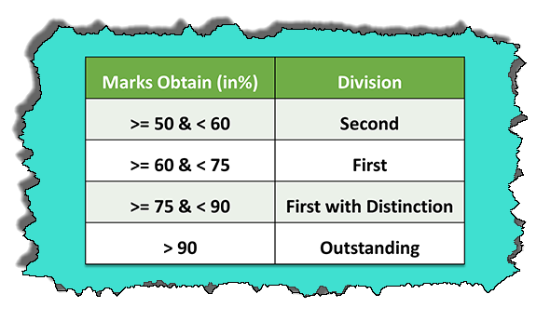
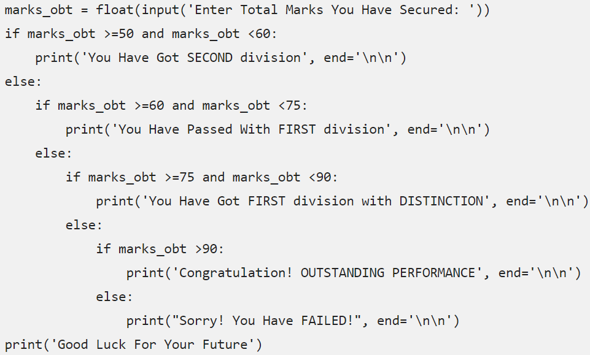
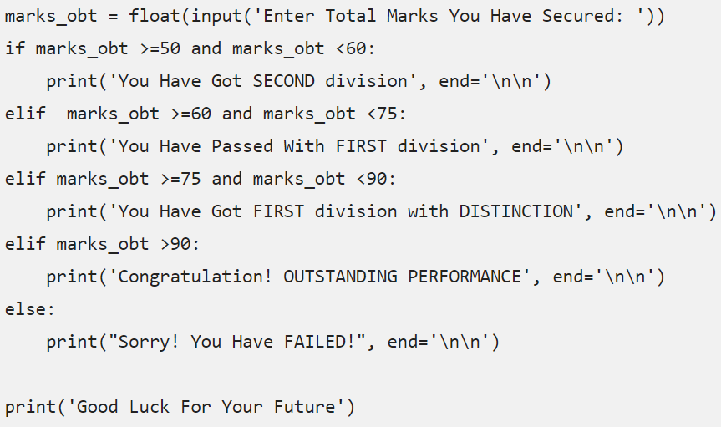
If-elif-else or nested if-else?
Student with marks over 50 and less than 60 has passed with the second division. Student with marks over 60 and less than 75 has passed with the first division. Whereas the student with marks over 75 and less than 90 has passed with the first division with distinction. And if a student has got marks over 90 then he or she has passed with an outstanding performance.
Read more: http://www.rebellionrider.com/the-best-ways-to-utilize-elif-python/

Slide 31
Class practice
Write a code (nested if) to check if an input is larger or less than 100. If the number is larger than 100, print out the result. Otherwise, check if it is an odd or even number. If it is an odd number, compute the value of log base 10 of it.

